Slide 1

WIPP Looking Forward
Greg Sosson
Acting CBFO Manager

Slide 2
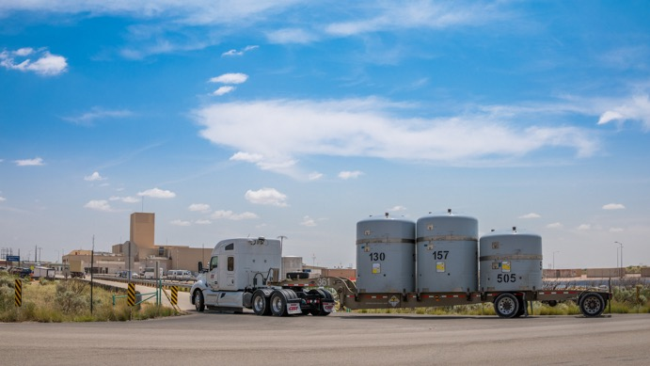
Shipment Projections
Projected Shipments through January 2021
Site | Projected Shipments Feb. 2020 – Jan. 2021
ANL | 5
INL | 195
LANL | 80
LLNL | 10
ORNL | 33
SNL | 3
SRS | 24
Total | 350 Estimated

Slide 3
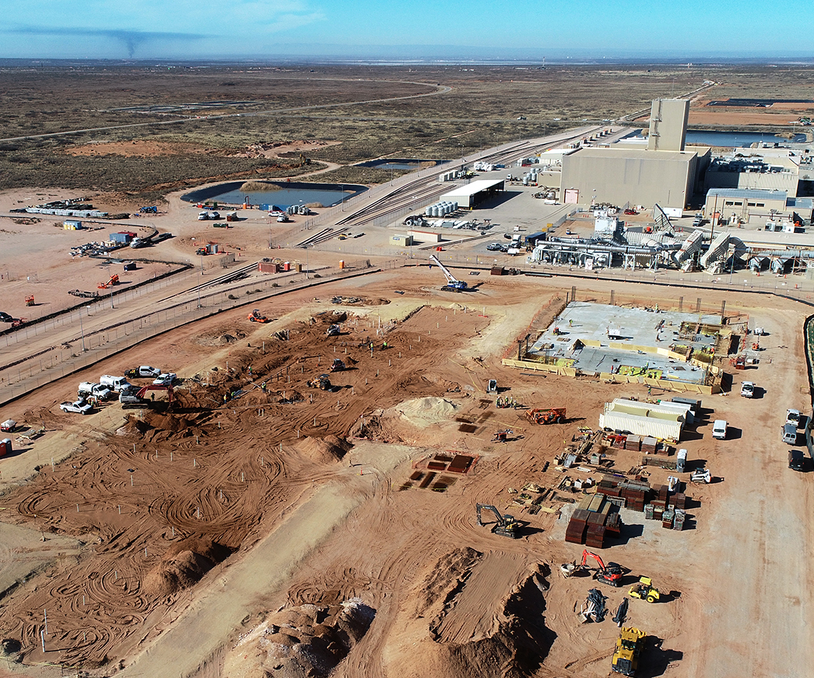
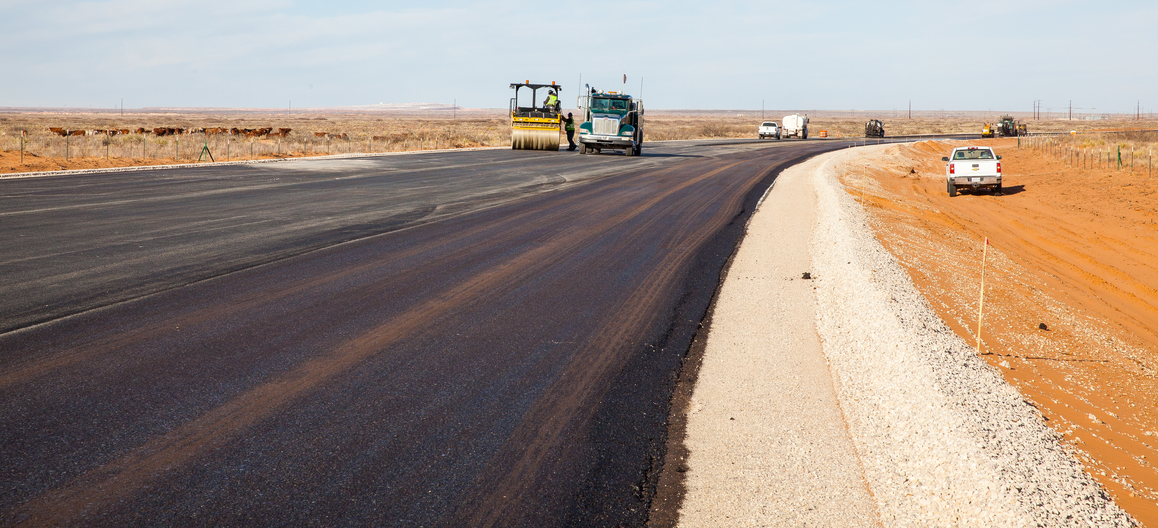
Capital Projects
  Safety Significant Confinement Ventilation System
  Utility Shaft project
  Hoisting capability project
  Completion of North Access Road Bypass

Slide 4
Looking Ahead – Investing in WIPP’s Future
General Plant Projects
  Underground electrical substation
  Fire loop system
  Central Monitoring Room upgrade
  Plant-wide fiber optics upgrade
  Salt hoist repair
  Completion of Panel 8

Slide 5

Regulatory Activities
Compliance Recertification Application 2019 – Currently under EPA review
Class 3 Permit Modification Request – Excavation of new shaft and associated connecting drifts
10 Year Hazardous Waste Facility Permit Renewal – March 2020 submittal

Slide 6
National TRU Program (NTP)
Implementing a fully-integrated NTP team approach across the complex:
New information processes improve communication between generator sites and CBFO Office of NTP
Strengthened site agreements between federal and contracting entities
Corporate approach to issue resolution

Slide 7
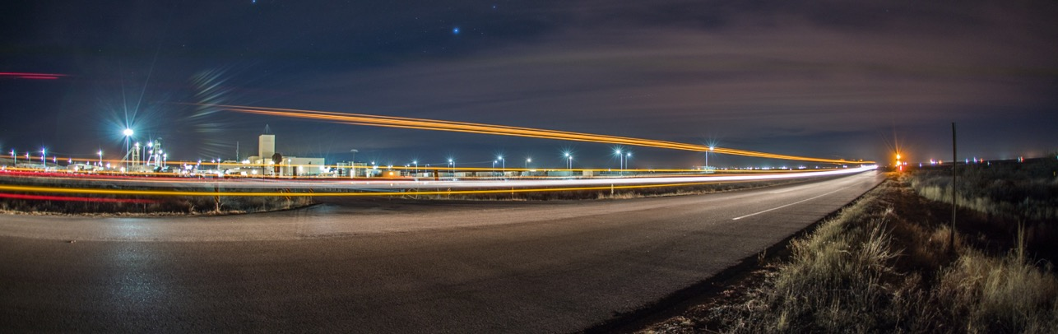
Questions?

